Slide 1

Decision Trees and Random Forests
Michigan Hackers Machine Learning Team

Slide 2

Today’s Agenda
Announcements
Icebreaker
Machine Learning Opportunities at UMich
Roadmap
Review Regularization
Decision Trees
Random Forest
Titanic Project
Work and Ask Questions

Slide 3
Announcements
The LSA Course Guide for Winter 2021 is out
Browse through the courses for next semester and see what you like
U-M Data Science Annual Symposium 2020
Dates: November 10-11
Attend to hear several research talk, network with professors and post-docs, and learning more about MIDAS
MIDAS Seminar Series: Paul Bennett – Microsoft
Date&Time: November 16th, 4-5 pm
Meet Paul Bennett who is a Senior Principal Research Manager at Microsoft

Slide 4



Ice Breaker
How did you celebrate Halloween this year?

Slide 5
ML Courses at UMich
Theoretical
Both
Practical
EECS 492: Artificial Intelligence
STATS 426: Data Analysis
EECS 477: Algorithms
EECS 445: Machine Learning
EECS 484: Database Systems
STATS 413: Regression Analysis
STATS 415: Statistical Learning
EECS 442: Computer Vision
EECS 485: Web Systems
EECS 476: Data Mining
EECS 496: Web Search
EECS 467: Autonomous Robotics
EECS 498: Special Topics

Slide 6
EECS 445 Pre-reqs
MATH 215: Calculus III
EECS 203: Discrete Math
EECS 280: Programming
MATH 214: Appl. Lin. Alg.
MATH 217: Linear Algebra
STATS 250: Intro Stats
MATH 425: Probability
EECS 281: Data Structures and Algorithms
EECS 445: Machine Learning

Slide 7




ML Research at UMich

Slide 8
Work for Rest of Semester
Strongly Recommended (highest to lowest priority)
Python Beginners: Complete through Course 3 of the Python 3 Programming specialization.
Kaggle Titanic Tutorial
Iris Classification
Coursera project: Pandas Python Library for Beginners in Data Science

Slide 9
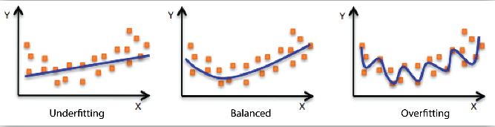
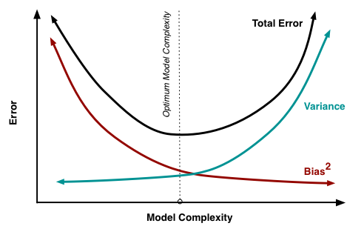

One Slide Review of Regularization
Overfitting vs Underfitting
Bias-Variance Trade Off
Regularization is a technique used for tuning the function by adding an additional penalty term in the cost function. The additional term controls the function such that the coefficients don't take large values, so as to avoid the risk of overfitting.
Ridge Regression

Slide 10

Regularized Logistic Regression in Python

Slide 11
Decision Trees

Slide 12
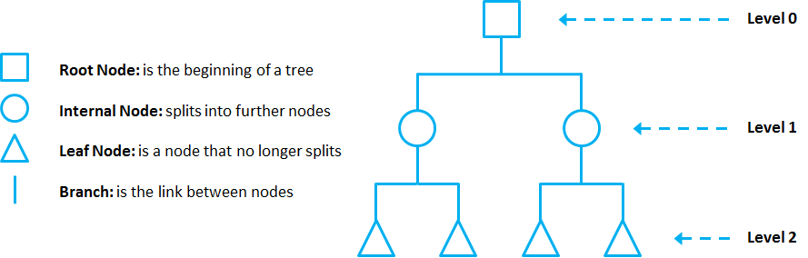
Anatomy of a Decision Tree
Decision Trees are ML algorithms that progressively divide data sets into smaller data groups based on a descriptive feature, until they reach sets that are small enough to be described by some label.

Slide 13
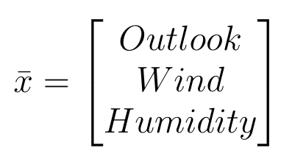
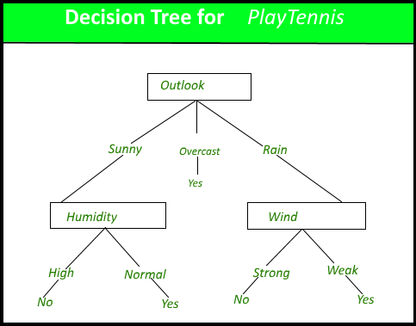
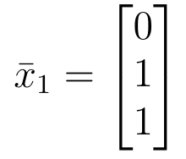
Decision Trees
Outlook: sunny = 0, overcast = 1, rain = 2
Wind: strong = 0, weak = 1
Humidity: high = 0, normal = 1

Slide 14
Entropy: Measure of Disorder
Reduction in entropy
No reduction in entropy

Slide 15
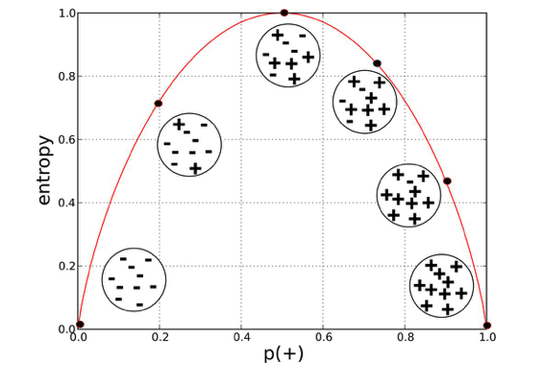

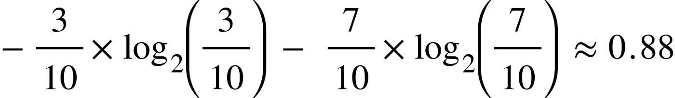
Calculating Entropy
Let’s say out of 10 data points, the labels of 3 are true and 7 are false. The entropy of those 0 points is given as follows.

Slide 16
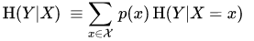
Conditional Entropy
Conditional Entropy is the uncertainty in the class label Y, if you knew the value of a specific feature X
It is the sum of the conditional entropy for every value label X takes

Slide 17
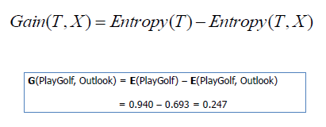
Information Gain
Information gain is the reduction in entropy or surprise by transforming a dataset and is often used in training decision trees. Information gain is calculated by comparing the entropy of the dataset before and after a transformation.
Information gain is used to decide which feature to split on at each step in building the tree. Simplicity is best, so we want to keep our tree small.

Slide 18
Random Forests

Slide 19
Bootstrapping
Idea: Use your training dataset to simulate multiple new training sets.
Randomly sample n data points from your training set k times, yielding k training sets of size n.
The resulting training sets will have some similarity to each other as a result of being drawn from the same original training set, but are somewhat different due to the random sampling.

Slide 20
Bagging (Bootstrap Aggregating)
First, make k training sets by bootstrapping
For decision trees: Train a different decision tree on each of the k training sets. When making a prediction, “ask” all decision trees and select the majority answer.
Called an ensemble method

Slide 21
Bagging (Bootstrap Aggregating)
training data
Bootstrapping
bootstrapped set
bootstrapped set
bootstrapped set
Training
decision tree
decision tree
decision tree
Ensemble Classification
OUTPUT

Slide 22
Random Forests
Idea: Introduce more randomness into bagging to reduce variance.
Previously, for each split in each of the k decision trees, split on the best feature (most information gain)
Now, for each split in each of the k decision trees, randomly select a subset of features and split on the best feature in the subset.
Effect: More randomness -> less similar trees -> less chance of overfitting (lower variance)

Slide 23
Titanic Project

Slide 24

Kaggle’s Titanic Project

Slide 25
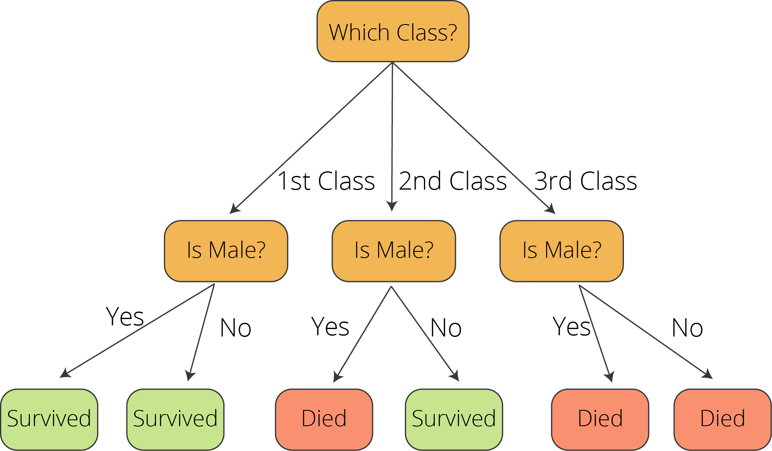
Kaggle’s Titanic Project Tutorial

Slide 26
Work for Rest of Semester
Strongly Recommended (highest to lowest priority)
Python Beginners: Complete through Course 3 of the Python 3 Programming specialization.
Kaggle Titanic Tutorial
Iris Classification
Coursera project: Pandas Python Library for Beginners in Data Science
Bonus
Intermediate: Read Chapter 17: Decision Trees in Data Science from Scratch
Experienced: Read Chapter 6 in Hands-On ML.
If you are brave enough, attempt the Titanic Project without following the tutorial!

Slide 27
Thank You!
Michigan Hackers Machine Learning Team
Contact Info:
Rajas Gupta | rajasg@umich.edu
Vijay Shamra | vsharm@umich.edu
Provide Feedback

